Slide 1
Pandas
Week 2 – More Scrapping!

Slide 2
01
Recap
Last week on the CS club meeting…

Slide 3
Web Scraping
HTML
Requests / BeautifulSoup
We learned about HTML Tags and Attributes.
p for paragraph
div for containers
li for list
Requests allow us to get fetch wepages and BeautifulSoup allow us to parse the HTML

Slide 4
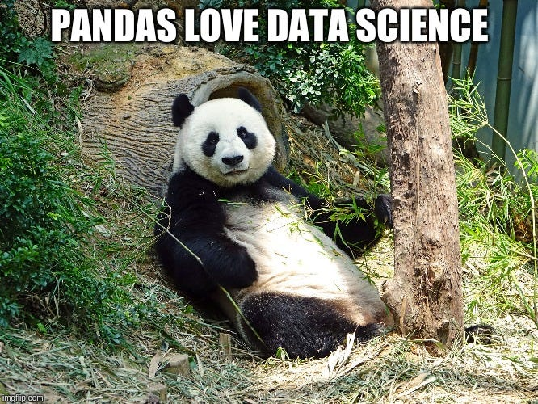
A picture is worth a thousand words
`

Slide 5
02
Pandas
What does a ghost panda eat? BamBOO!

Slide 6
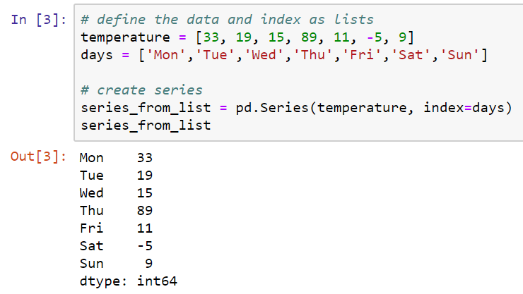
Pandas basics
Pandas is a library used for data manipulation and data analysis.
CVS / Excel
Series and Dataframes

Slide 7
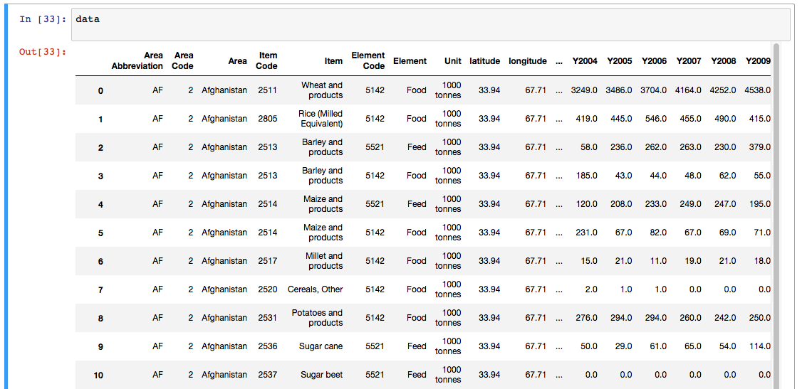
Dataframes
Similar to a Excel/SQL table

Slide 8
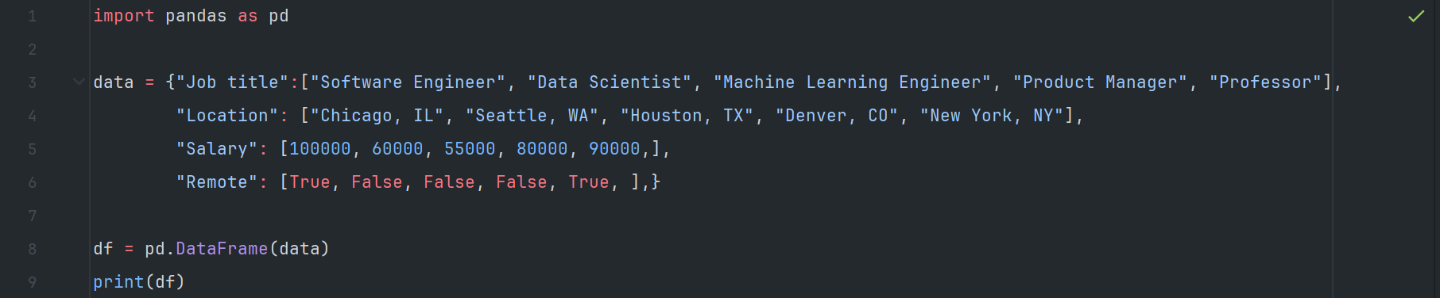
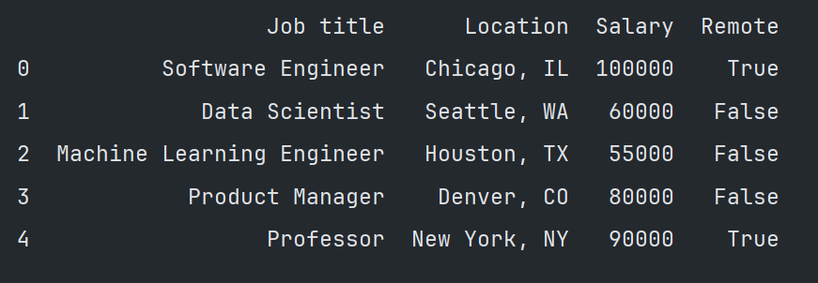
Creating a dataframes

Slide 9
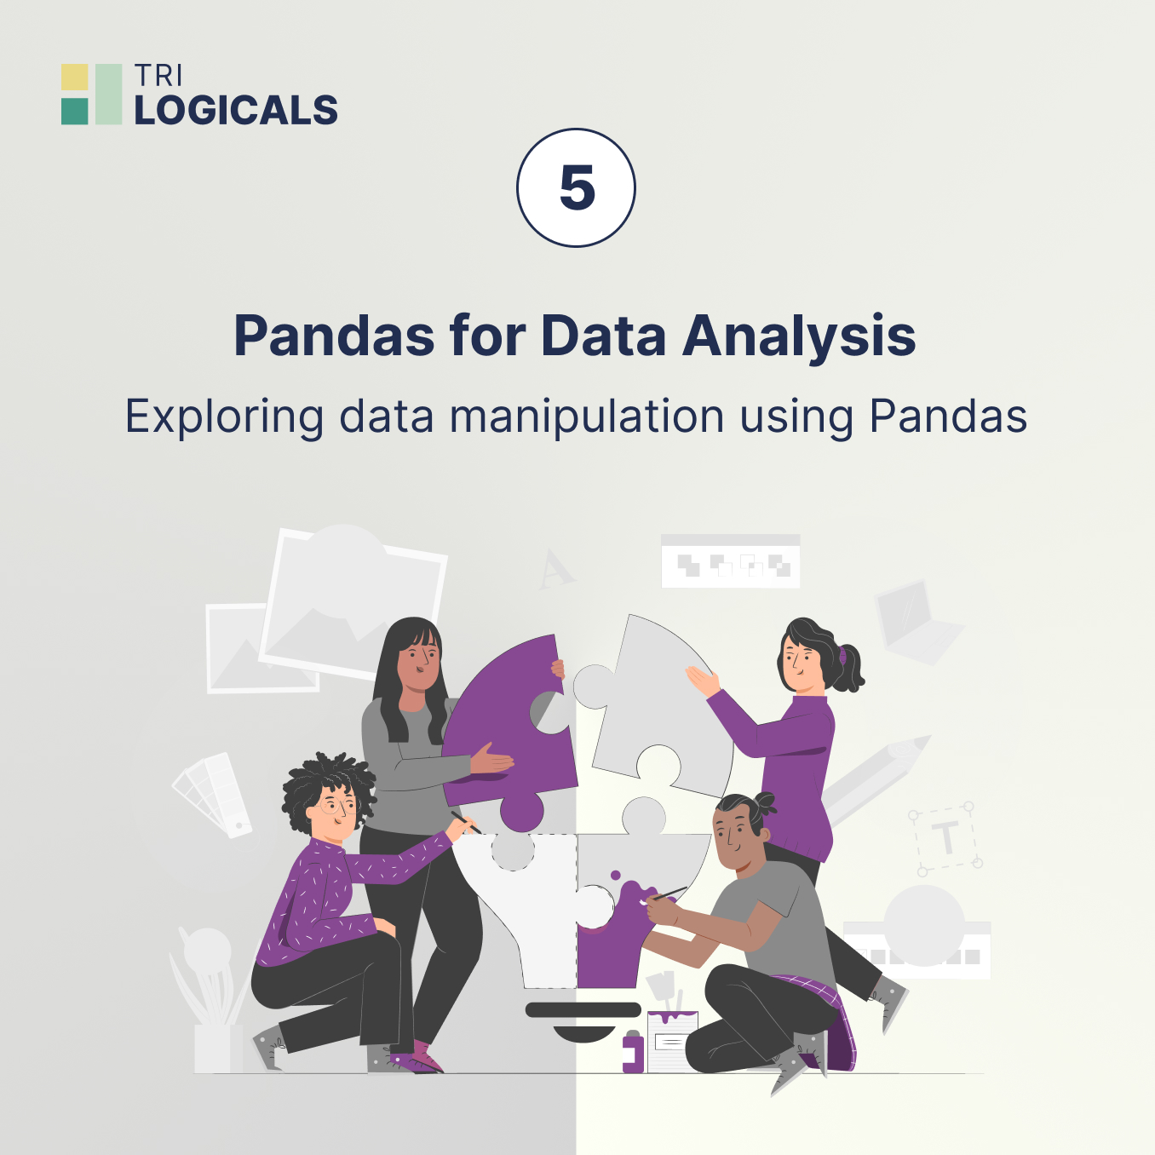
Dataframes
Data Manipulation
Access a column
Access a specific row
Display specific values

Slide 10
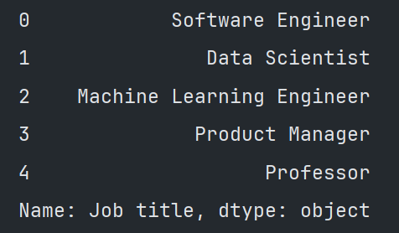
Dataframes
Access a specific column
df["Job title"]

Slide 11
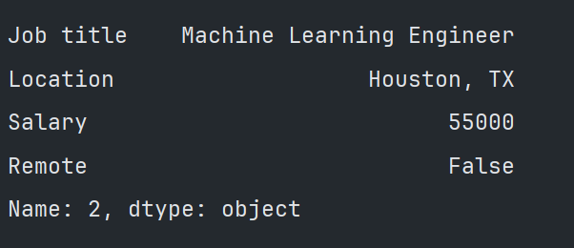
Dataframes
Access a specific row with iloc
df.iloc[2]
iloc – Integer location by index

Slide 12
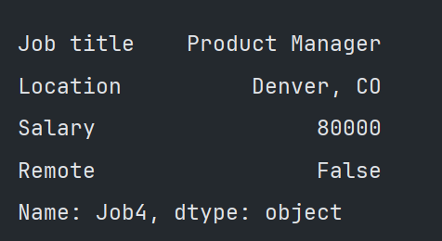
Dataframes
Access a specific row with loc
df.loc[“job4”]
loc – Access a group of rows and column by label

Slide 13
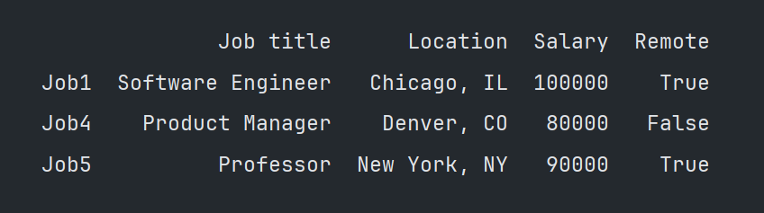
Dataframes
Display all values > $65000
df[df["Salary"] < 65000, ascending = true]

Slide 14
How can we use Pandas for web scraping?

Slide 15
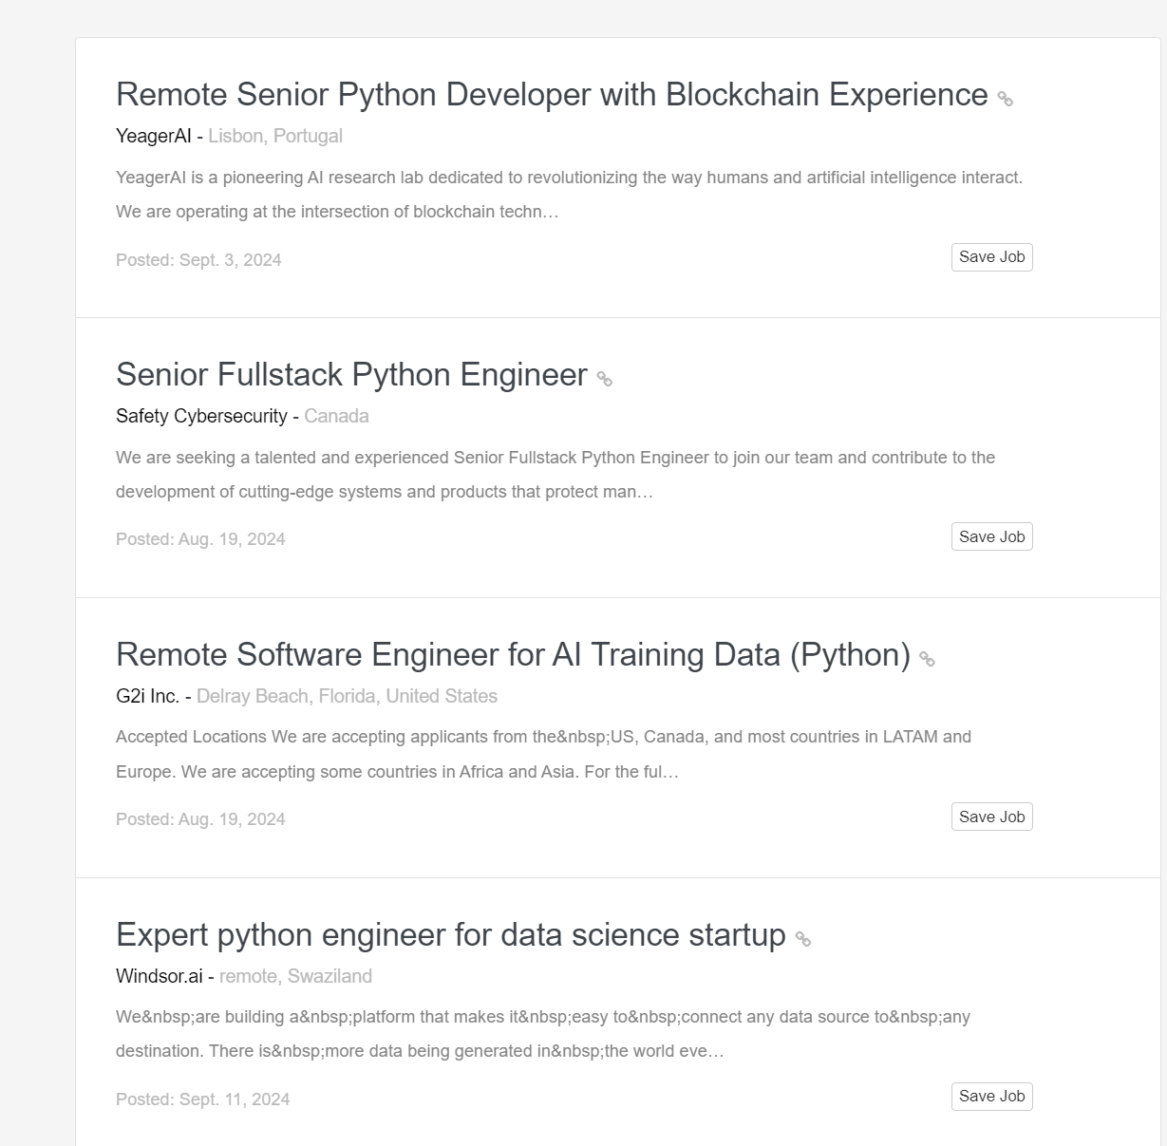
`

Slide 16
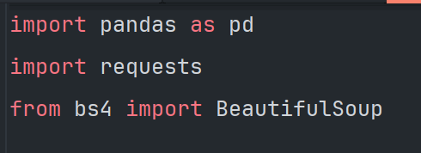
1. Import the necessary libraries

Slide 17
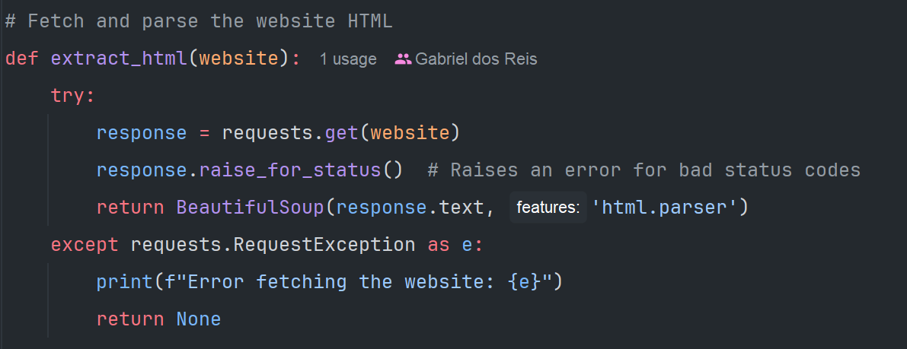
2. Fetch the website

Slide 18
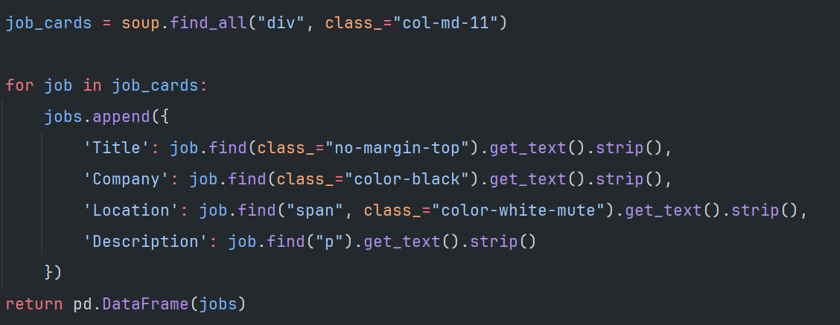
3. Collect the elements

Slide 19
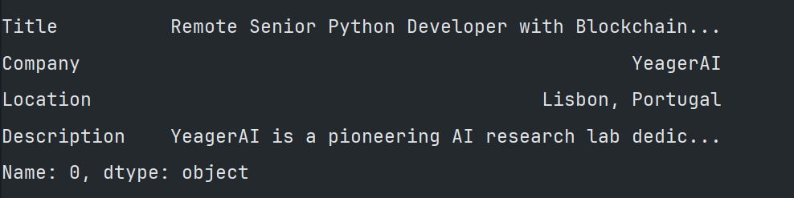
4. Ta daaaa

Slide 20
Thanks!

